Slide 1
Project Proposal
Proteome Screen: RNA-binding proteins in non-synchronized HeLa cells
Topic 3, Group 1
Julian Baureis, Julia Ferdin, Benjamin Nicklas, Luisa Wintel
Supervisor: Maiwen Caudron-Herger

Slide 2
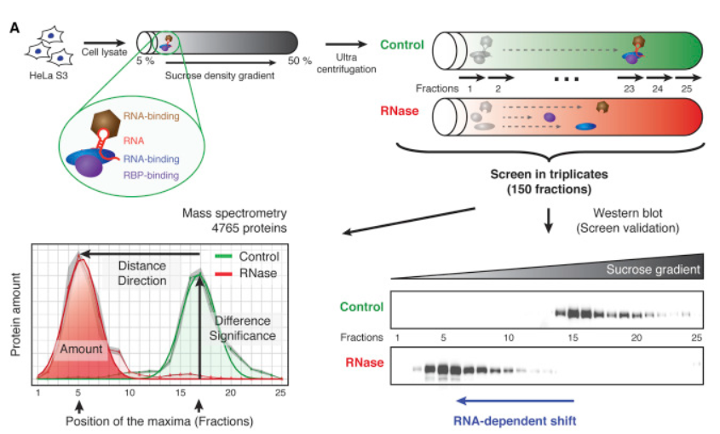
R-DeeP – Principle
RNA degradation leads to dissolved RNP-complexes
Released proteins migrate into different density fractions
Quantity of peptides in the different density fractions is analyzed
An RNA-dependent protein must exhibit a significant shift
Adapted from: Caudron-Herger, M., Rusin, S.F., Adamo, M.E., Seiler, J., Schmid, V.K., Barreau, E., Kettenbach, A.N., and Diederichs, S. (2019). R-DeeP: Proteome-wide and Quantitative Identification of RNA-Dependent Proteins by Density Gradient Ultracentrifugation. Molecular Cell 75, 184-199.e110.

Slide 3
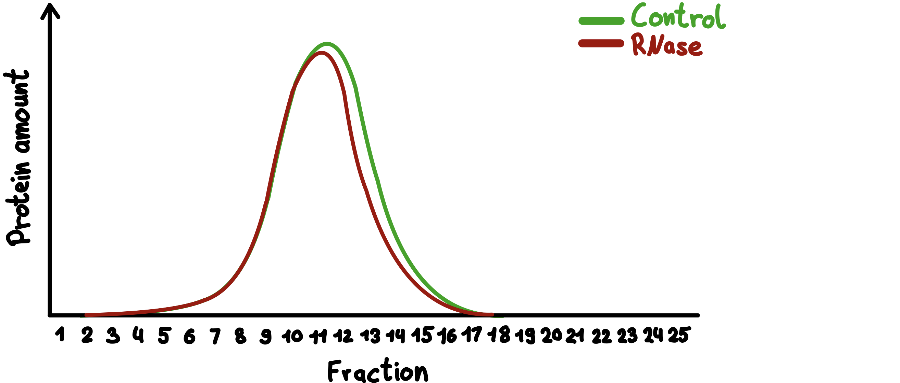
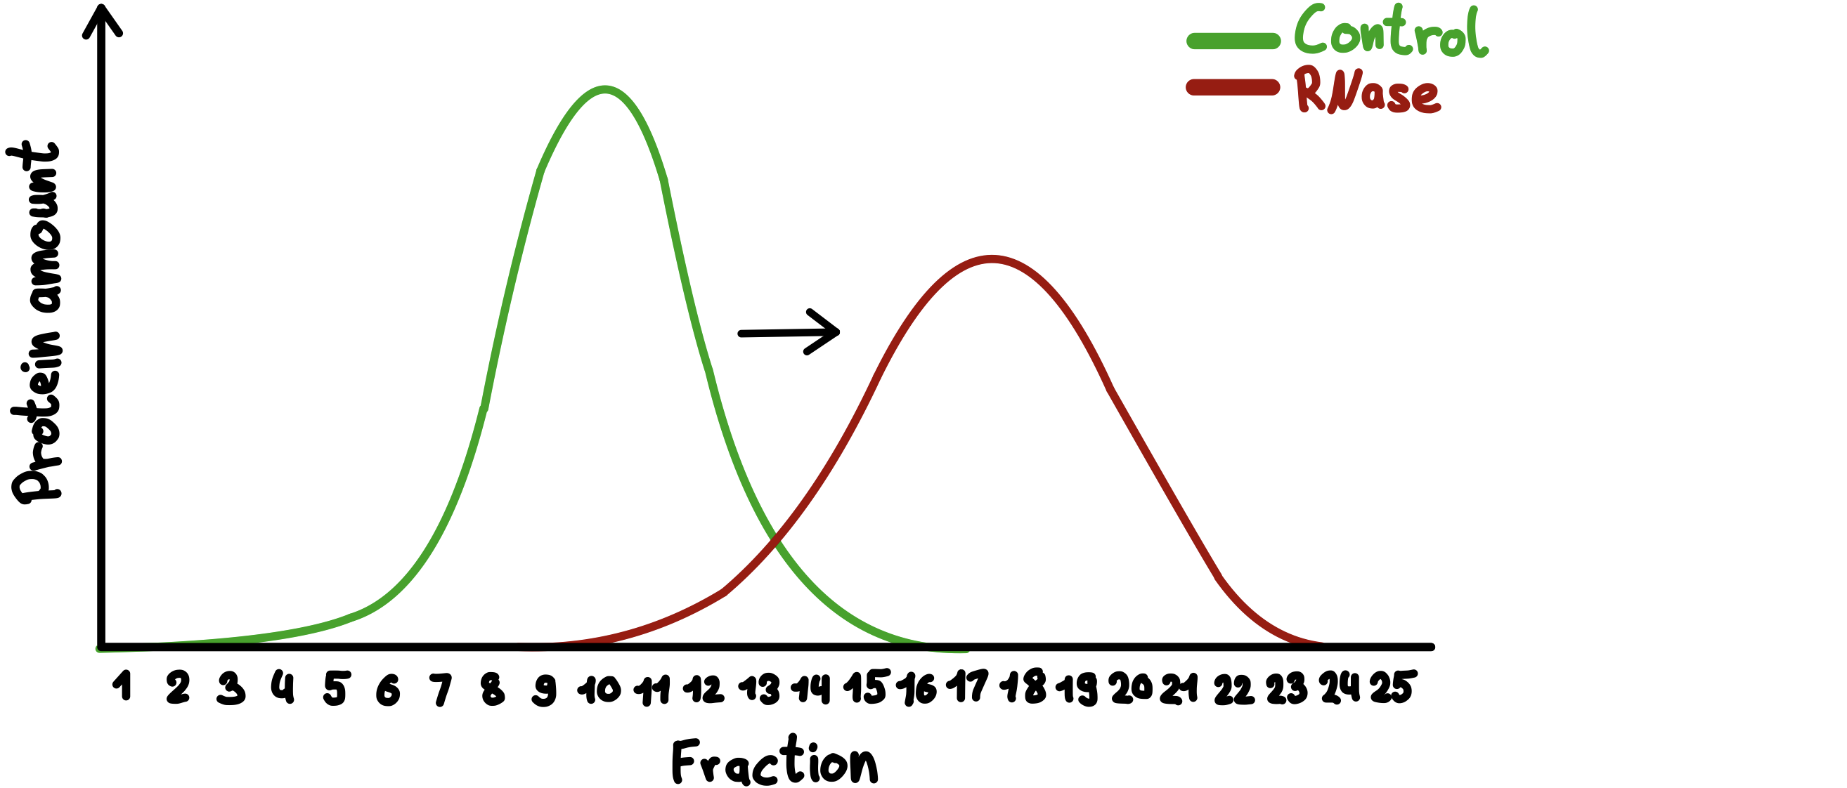
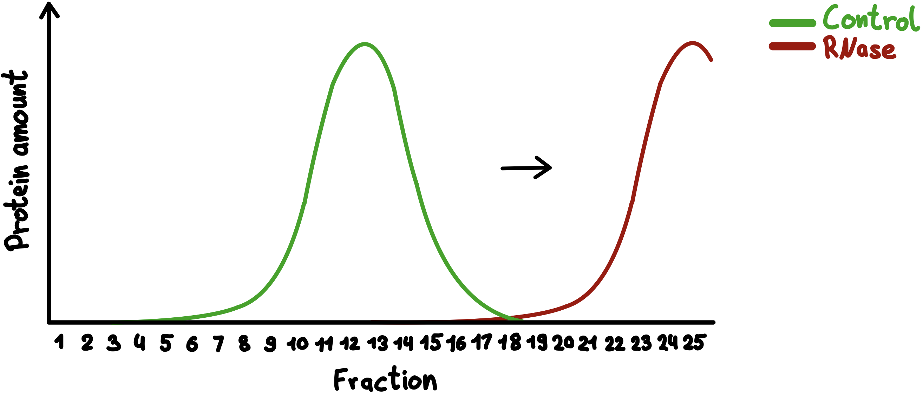
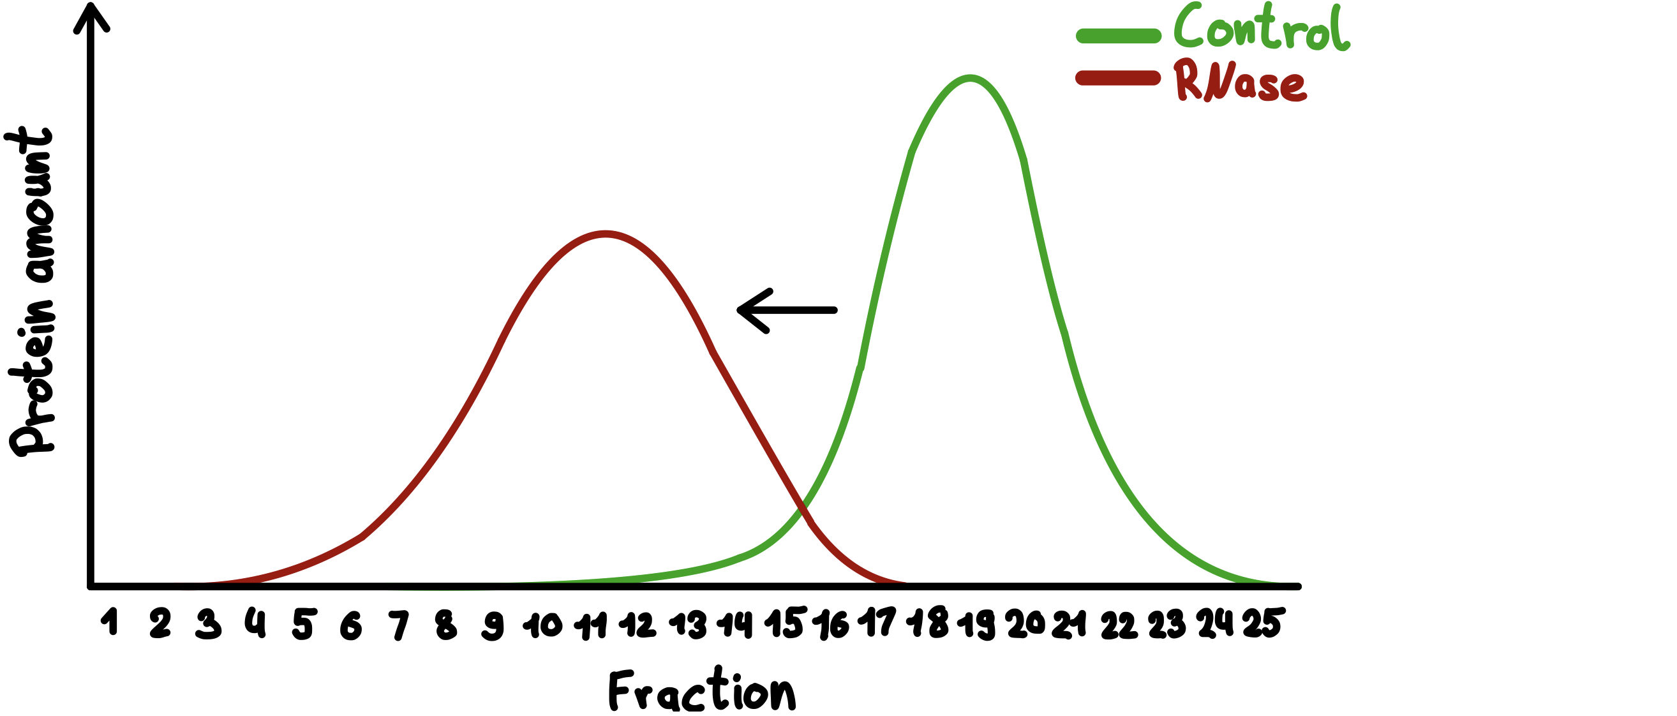
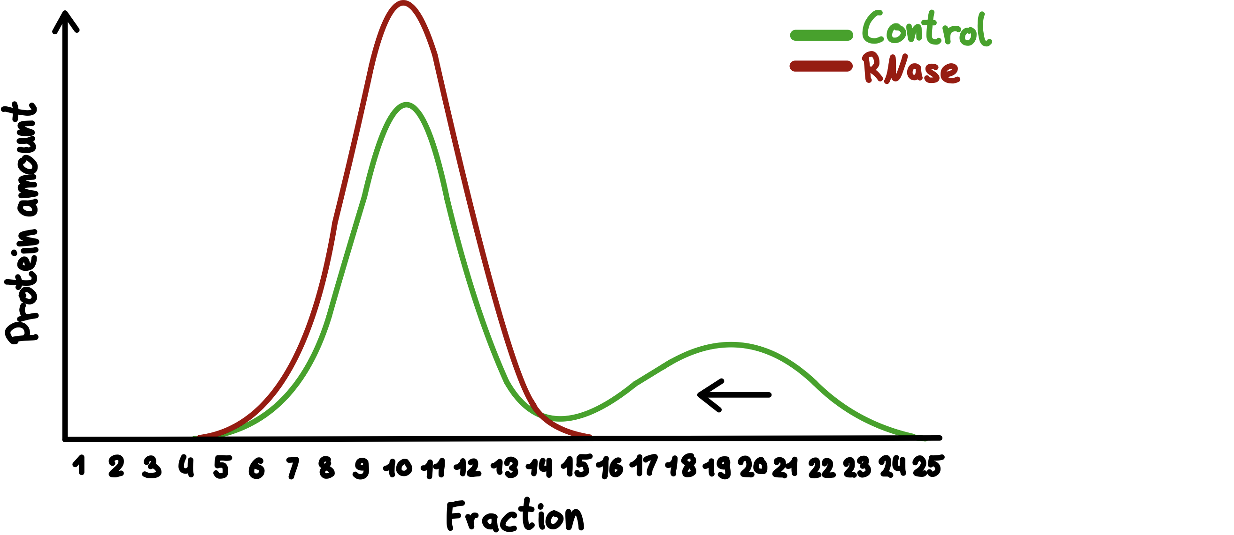
Meaning of the shifts
No shift (3.)
Right shift (1.)
Precipitated (1.)
Classification of proteins:
1. RNA-dependent
2. Partially RNA-dependent
3. Not RNA-dependent
Left shift (1.)
Partial shift (2.)

Slide 4
What is our data set showing?
Control and RNase fractions
Different Proteins
Dimension: 4765 x 150
Mass spectrometric quantitative results per protein per fraction
Comparison of the occurence of proteins in different fractions of Control and RNase
→ Which proteins are RNA-dependent?

Slide 5
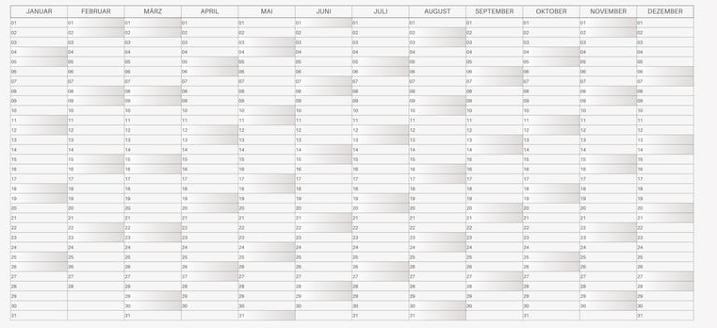
Time Table
https://www.google.com/url?sa=i&url=https%3A%2F%2Fwww.canva.com%2Fde_de%2Fkalender%2Fvorlagen%2F&psig=AOvVaw155hoQifX2EsWfPgBXsQLG&ust=1747057183090000&source=images&cd=vfe&opi=89978449&ved=0CBQQjRxqFwoTCIiCqKzFm40DFQAAAAAdAAAAABAE

Slide 6
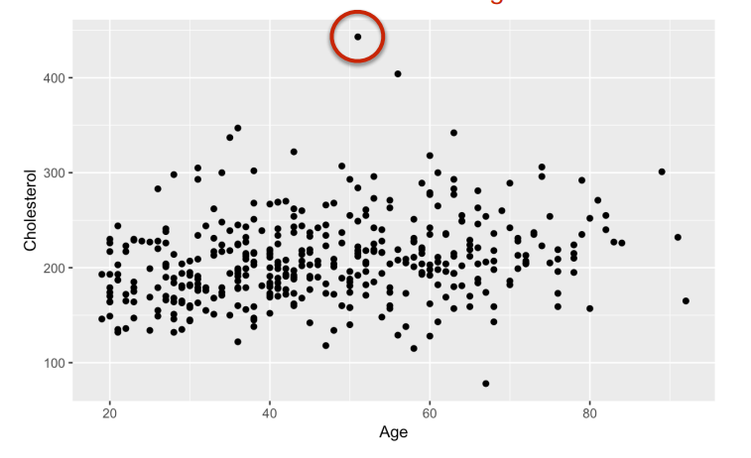
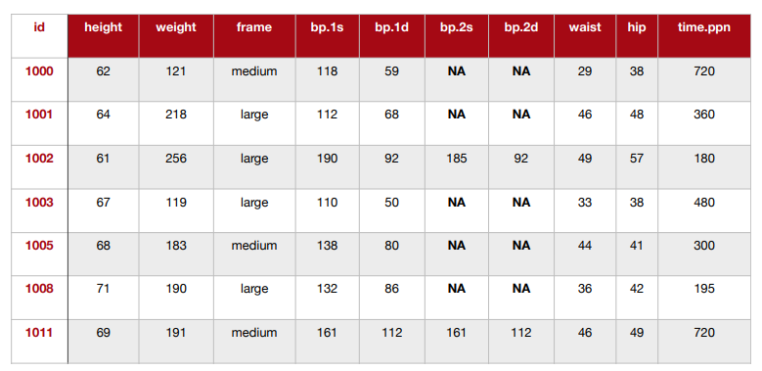
1. Week
19.05.-25.05.
Data cleanup
Removing low variance columns/rows
Removing batch effects
Removing technical outliers
Re-ordering data
Bioinfo-Slides aus dem 3. Semester

Slide 7
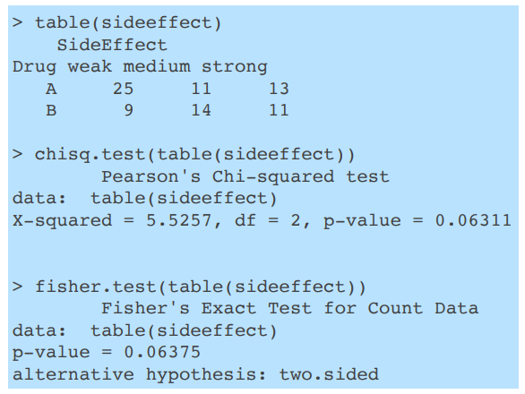
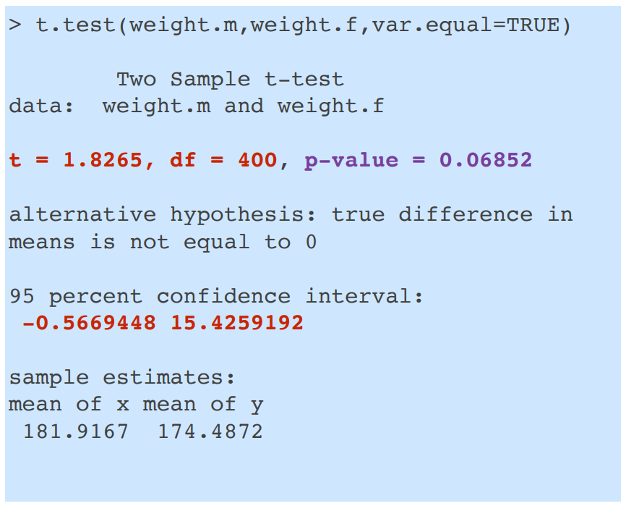
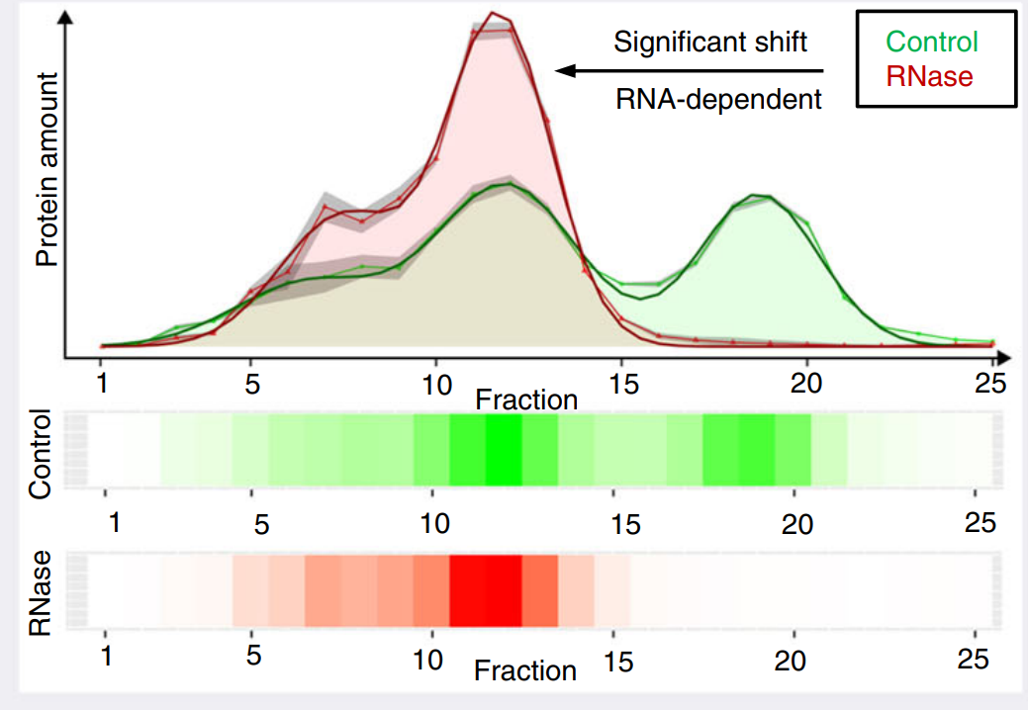
2. Week
26.05.-01.06.
Data exploration
data distribution
t-test
proportion test
Bioinfo-Slides aus dem 3. Semester

Slide 8
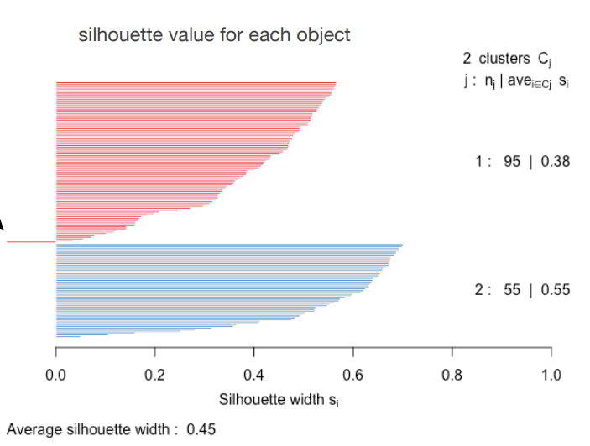
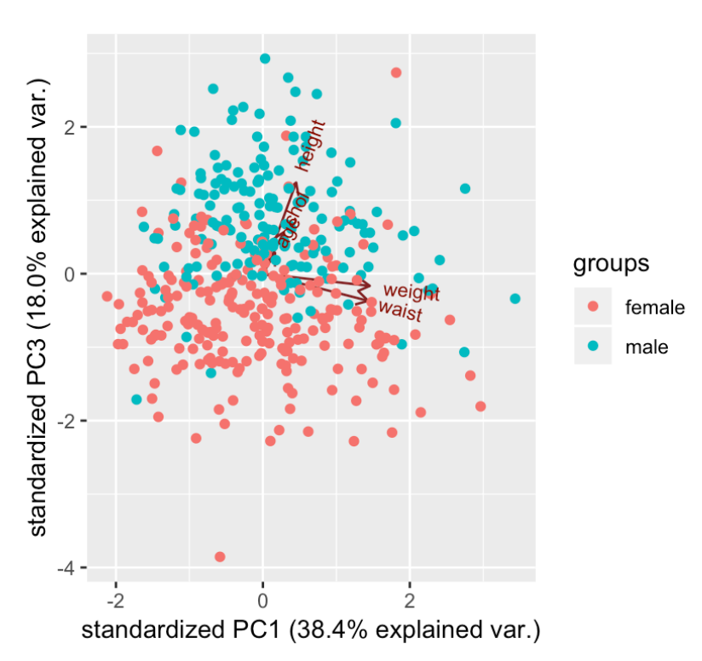
3./4. Week
02.06.-15.06.
Data reduction
PCR
k-means
linear regression analysis
Bioinfo-Slides aus dem 3. Semester

Slide 9
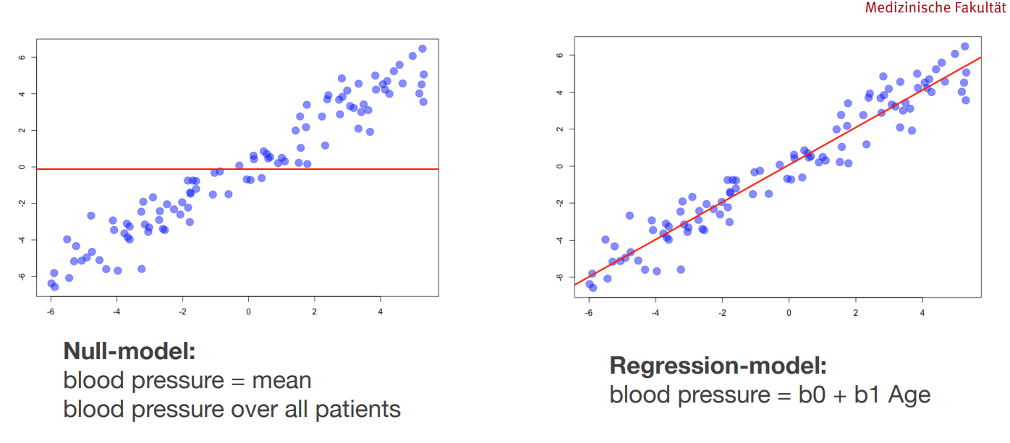
Bioinfo-Slides aus dem 3. Semester

Slide 10
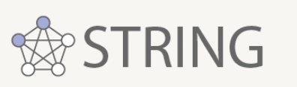

5.-7. Week
16.06.-06.07.
Data modelling
Data presentation
define selection criteria for RNA-dependent proteins
predict whether a protein is a RNA-dependent proteins
poster
final presentation

Slide 11
Thanks for listening

Slide 12
Detection of all RNA-dependent proteins, that interact direclty or indirectly with RNA
Proteome-wide, unbiased, enrichment-free screen
Vorteile: Enrichment-free: Basiert nicht auf den Unterschieden von Affinität oder Eigenschaften der einzelnen Proteine, auch nicht auf bestimmten RNA/Protein-Sequenzen, liefert quantitative Aussagen über den Anteil jedes RBP, der tatsächlich an die RNA angelagert ist
Limitationen: Identifiziert nicht die binding sites, keine Unterscheidung zwischen direkten und indirekten Interaktionen

Slide 13
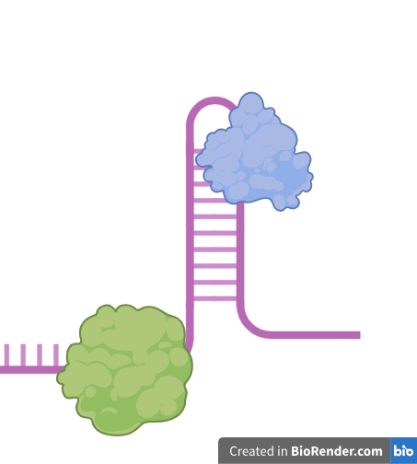
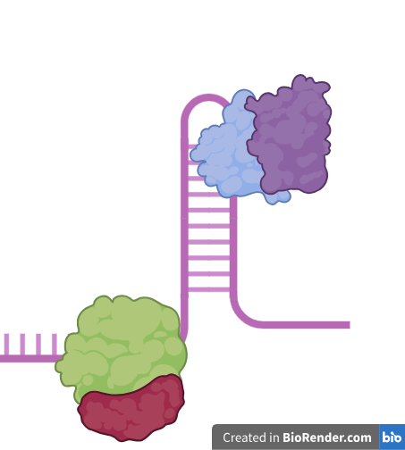
RNA-binding proteins non-synchronized HeLa cells

Slide 14
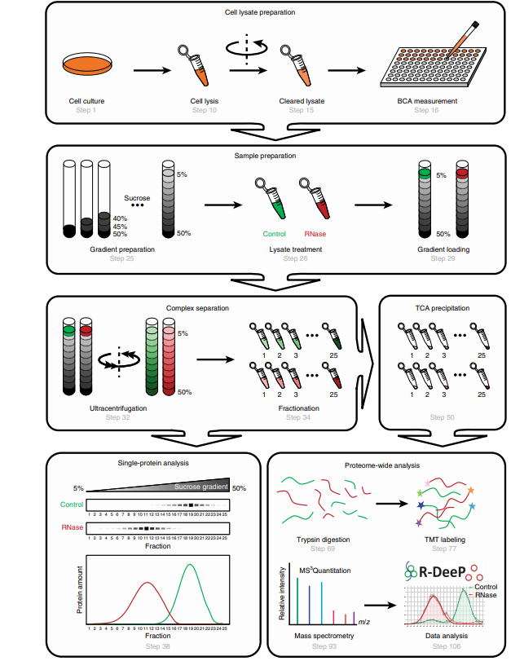
RNA dependence (R-DeeP)
Caudron-Herger et al., Identification, quantification and bioinformatic analysis of RNA-dependent proteins by RNase treatment and density gradient ultracentrifugation using R-DeeP, 2020, Nature Protocols

Slide 15
R-DeeP – Principle
RNA degradation leads to dissolved RNP-complexes
Released proteins migrate into different density fractions
Quantity of peptides in the individual density fractions analyzed by western blotting or mass spectrometry
An RNA-dependent protein must exhibit a significant shift
Adapted from: Caudron-Herger, M., Rusin, S.F., Adamo, M.E., Seiler, J., Schmid, V.K., Barreau, E., Kettenbach, A.N., and Diederichs, S. (2019). R-DeeP: Proteome-wide and Quantitative Identification of RNA-Dependent Proteins by Density Gradient Ultracentrifugation. Molecular Cell 75, 184-199.e110.

Slide 16
Meaning of the shifts
No shift (3.)
Right shift (1.)
Precipitated (1.)
Classification of Proteins:
1. RNA-dependent
2. Partially RNA-dependent
3. Not RNA-dependent
Left shift (1.)
Partial shift (2.)

Slide 17
What is our data set showing?
Control and RNase fractions 1-25 in triplicates
Dimension: 4765 x 150
Different Proteins
Mass spectrometric quantitative results per protein per fraction
Allows relative comparison of the occurence of proteins in different fractions
→ Which proteins in the non-synchronized HeLa cells are RNA-dependent proteins?

